Slide 1
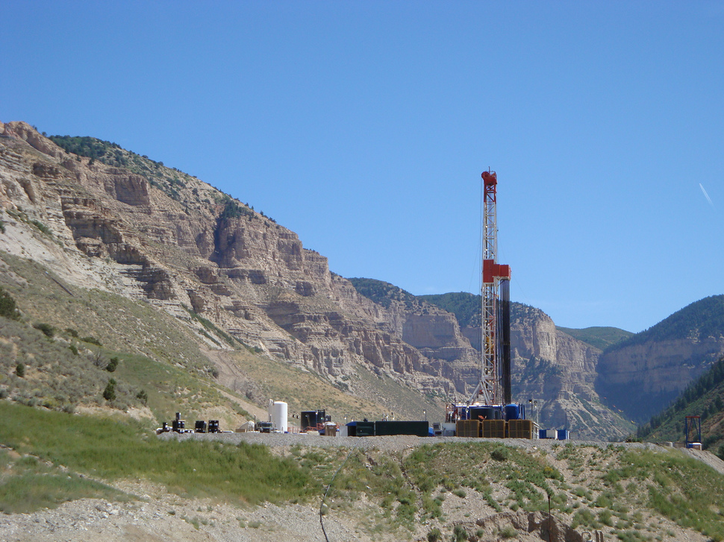
Safety In The
Oil & Gas Fields
2014

Slide 2
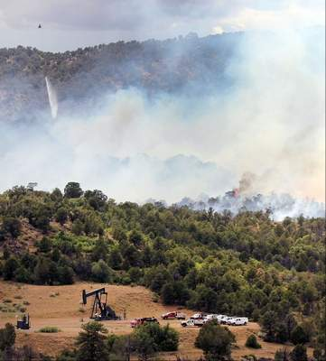
SITUATIONAL AWARENESS
• Maintain situational awareness in the oil and gas field
• Identify and communicate hazards
• Monitor your environment and those around you

Slide 3
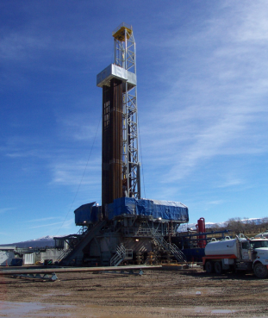
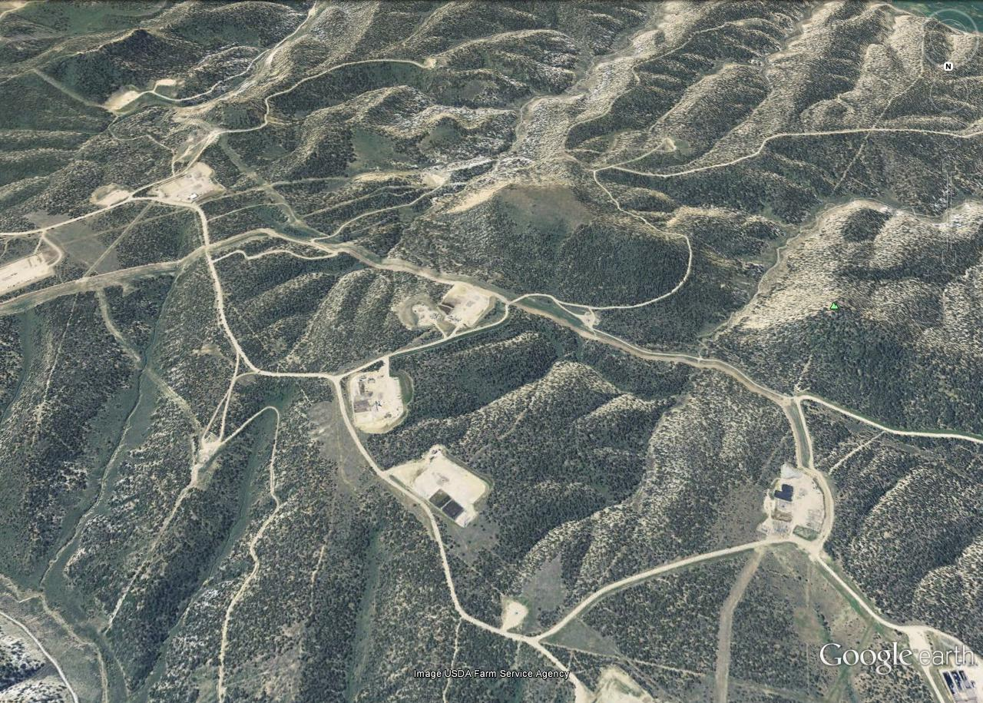
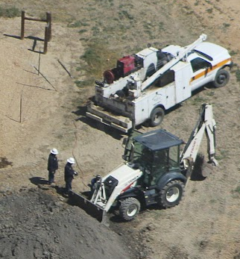

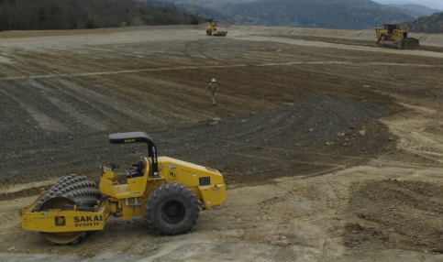
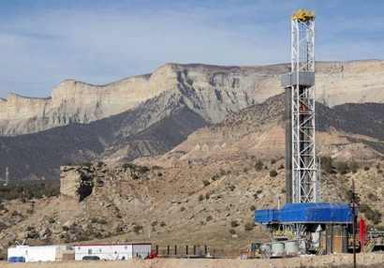
Incident Command can quickly begin to focus on public health & safety rather than suppression. Be prepared to initiate evacuations. Take a good look around before getting your head down. On the “Whistle” fire in 2008 there were 90 people, 45+ vehicles & heavy traffic on the main access road; all within a 2 mile radius of the fire.
Wind
14 acres
8 Personnel
2 Vehicles
44 Personnel
20+ Vehicles
12 Personnel
4 Heavy Equipment
6 Vehicles
26 Personnel
15+ Vehicles

Slide 4
WHISTLE FIRE: BLM & Rio Blanco Cty Law Enforcement closed the road directly adjacent to the fire. The large well pad at the road closure was designated as emergency parking for any misc. traffic if needed. Pads A & B left the area voluntarily. 8 personnel & 4 vehicles remained on Pad C. All personnel on Pad D remained on site; it was large enough to ride out the fire’s passage & it was determined it was safer to keep them in place rather than clogging the main access road for in-coming suppression resources with unnecessary traffic.
Access Route
For Incoming
Resources
14 acres
44 Personnel
20+ Vehicles
REMAINED
ON SITE
8 Personnel
2 Vehicles
EVACUATED VOLUNTARILY
SAFETY
ZONE
D
Staging
A
This large open pad was to be used as a
safety zone for any misc. traffic
C
B
26 Personnel
15+ Vehicles
ESSENTIAL PERSONNEL ONLY REMAINED
ON SITE & WOULD EVACUATE IF NECESSARY
12 Personnel
4 Heavy Equipment EVACUATED VOUNTARILY
6 Vehicles

Slide 5
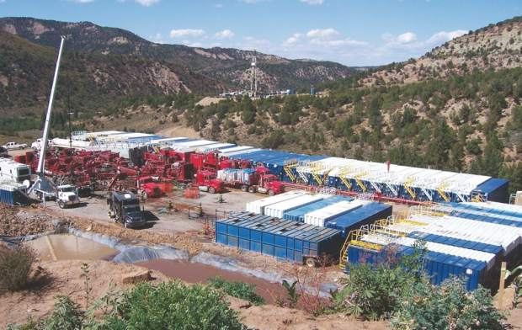
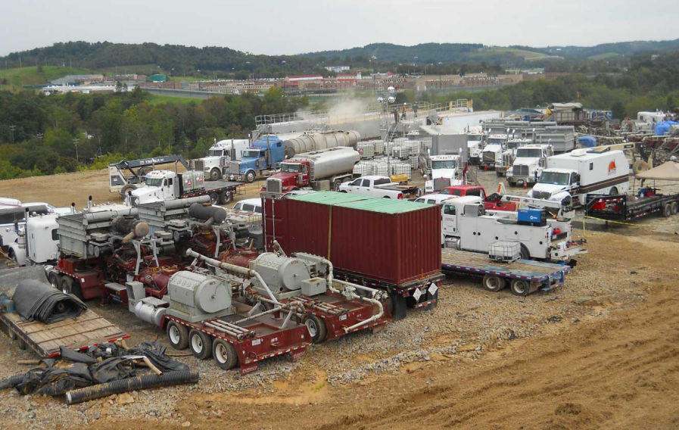
FRAC OPERATIONS
PERSONNEL: 20-30
HAZARDS:
Heavy vehicle & equipment congestion
High pressure surface lines
Trip hazards
Flammables & chemicals on site
Flow back tanks and pits
Possibility of explosives for
perforation operations
Just imagine facilitating the safe & timely evacuation of this many people & vehicles

Slide 6
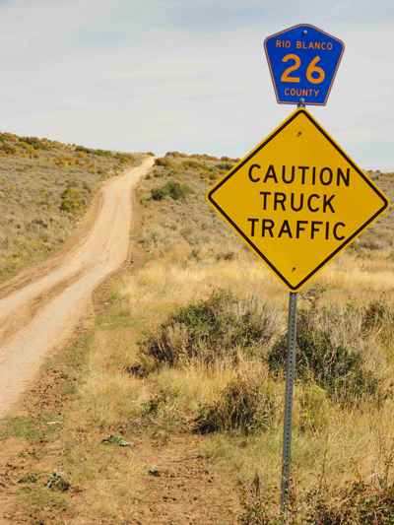
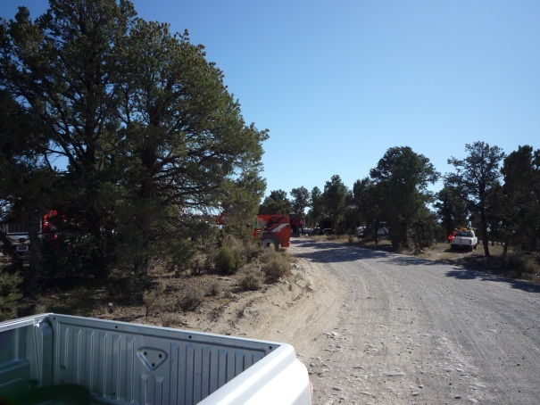
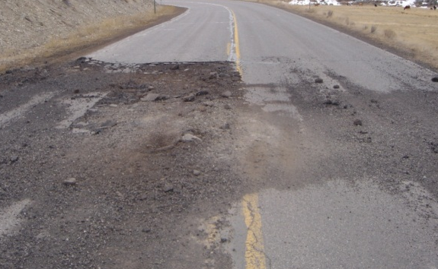
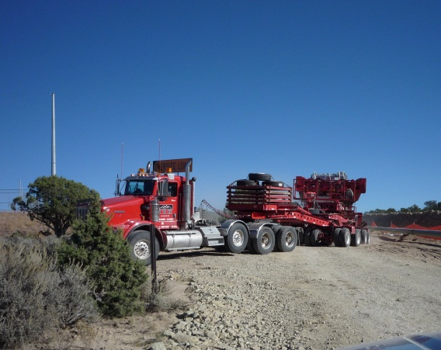
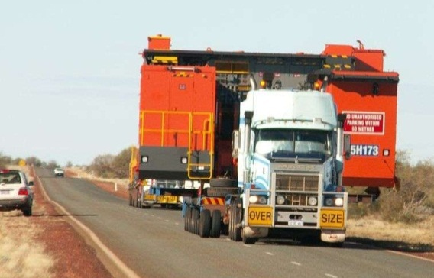
DRIVING HAZARDS
Access & Egress
can be hampered
WATCH FOR:
NARROW ROADS
BLIND CORNERS
HEAVY TRAFFIC
ROAD DAMAGE
WIDE LOADS
DRIVE DEFENSIVELY
Plan to share the road!

Slide 7
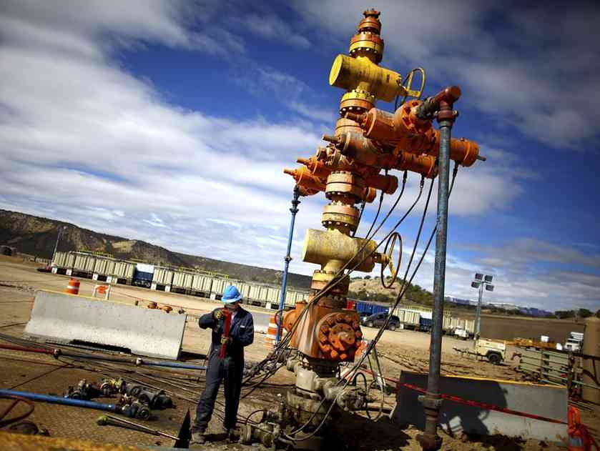
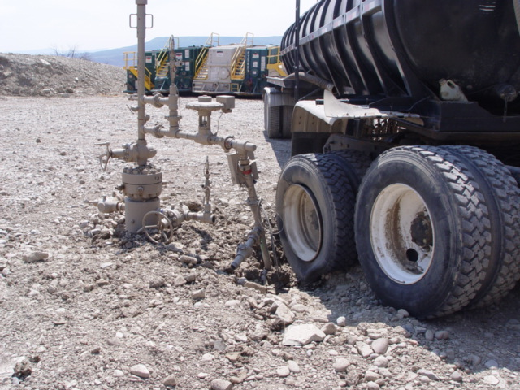
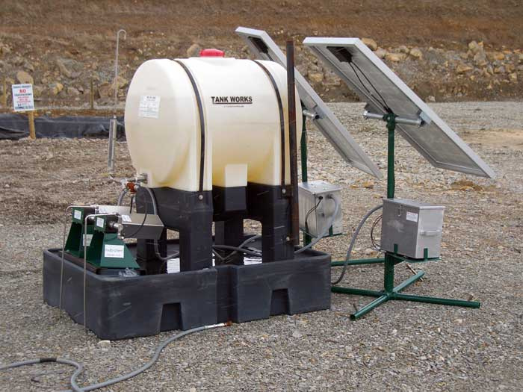
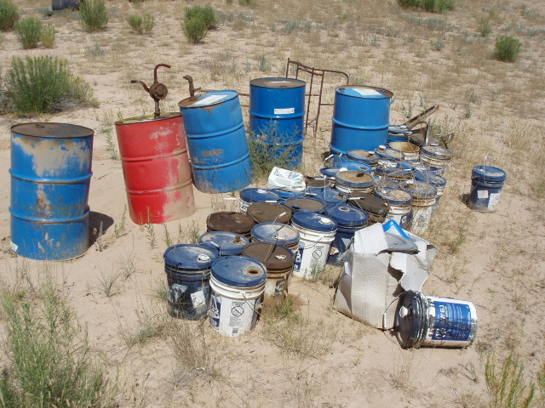
HAZARDS ON THE PAD
HIGH PRESSURE
SURFACE LINES
DRIVING OBSTRUCTIONS
TRIP HAZARDS
FLAMMABLES
HAZMAT

Slide 8
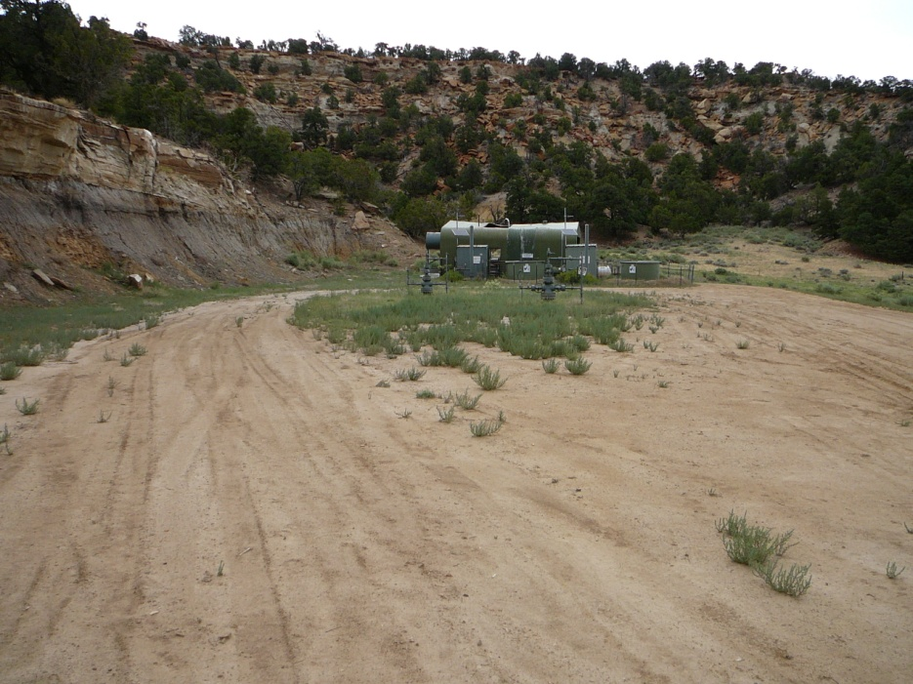
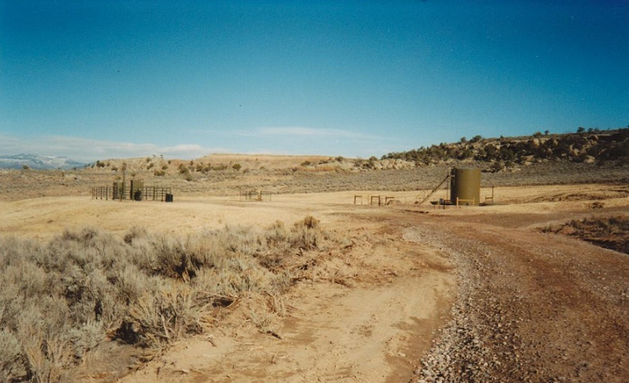

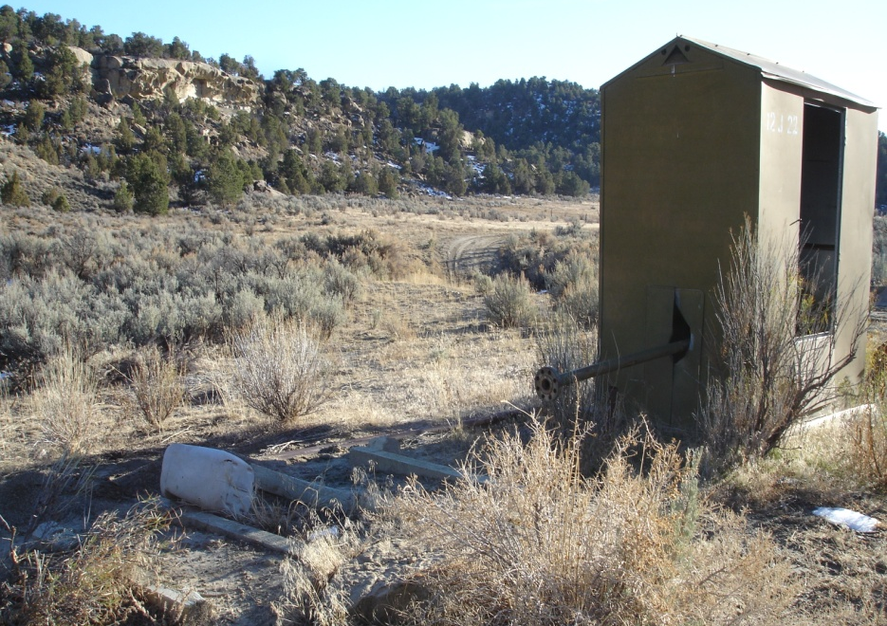
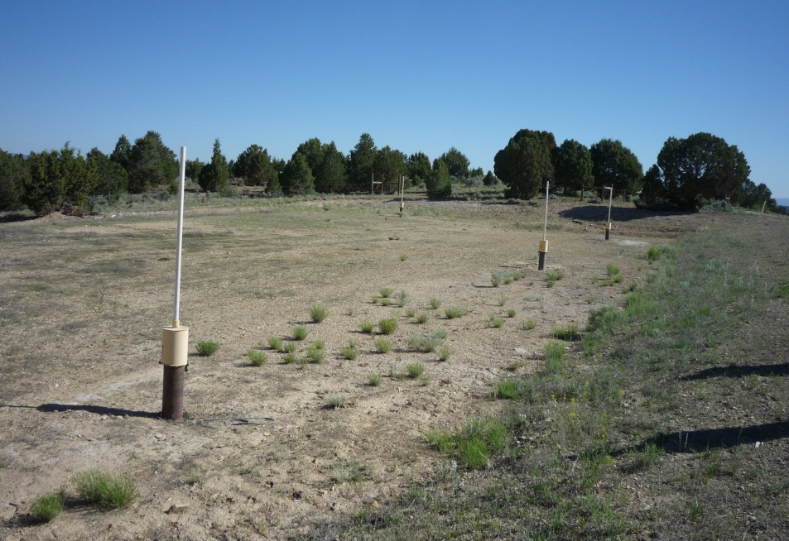


Are Well Pads A Safe Haven??

Slide 9
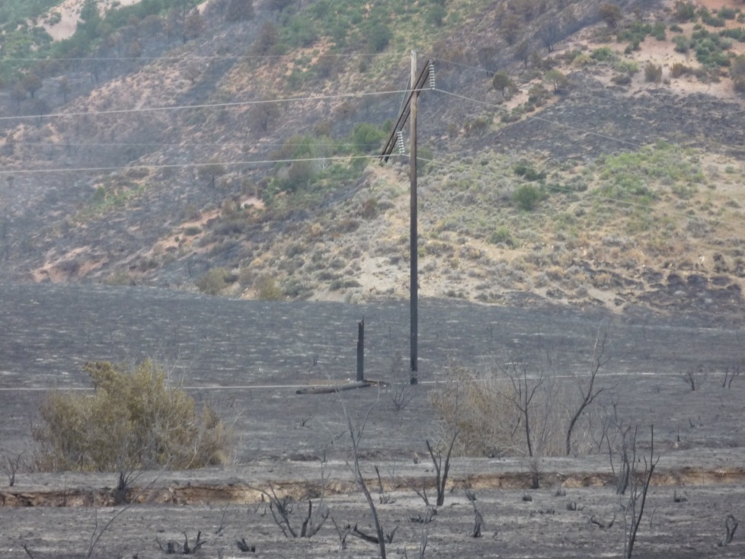
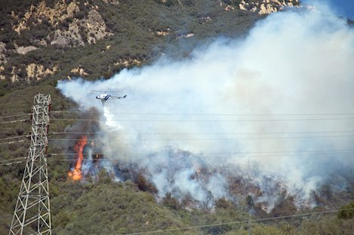
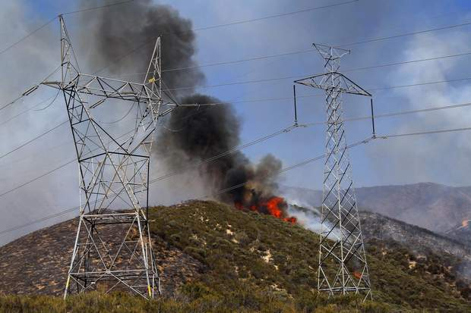
POWER LINES
Hundreds of miles of various transmission & distribution lines cross the landscape.
Power lines pose a unique hazard & warrant mitigation actions that reduce risk to both ground personnel and aircraft.
Refer to “Power Line Safety”
on pages 22 & 23 of the IRPG.

Slide 10
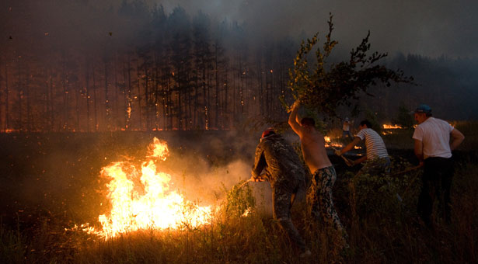
UNORGANIZED SUPPRESSION
EFFORTS!!!
WATCHOUT SITUATIONS:
Untrained and unequipped oil and gas personnel suppressing fire.
Unsupervised heavy equipment.
Determine who is in command.
Assume command or help devise a sound tactical plan of action.
Be honest, if you see serious safety concerns, insist on mitigation actions.
Only engage the fire when it has been determined it is safe to do so. If conditions warrant, disengage from the fire.
GOOD INTENTIONS
ARE NO SUBSTITUTE FOR
SAFETY
Don’t get drawn into
unorganized suppression efforts

Slide 11
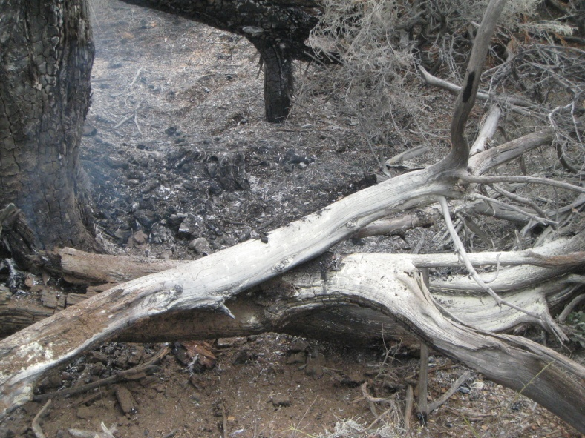
FIRE EXTINGHUISHERS
It is not uncommon to find that industry personnel have attempted to suppress a fire prior to the arrival of suppression resources. These fire extinguishers are not meant for suppressing large wildland fuels.
Three wildland firefighters on the NWCFMU were exposed to toxic fumes in 2008. One required medical treatment for irritation to the respiratory tract, shortness of breath, and severe headaches.
LOOK FOR FIRE EXTINGUISHER RESIDUE
The substance decomposes above 212°F and releases ammonia, nitrogen & phosphorous oxides.
Avoid exposure to the smoke and fumes produced by the burning residue.
Back off and monitor or construct your line in a safer location!!!

Slide 12
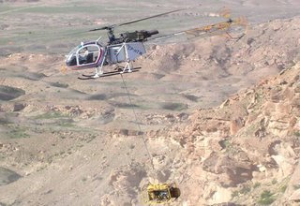
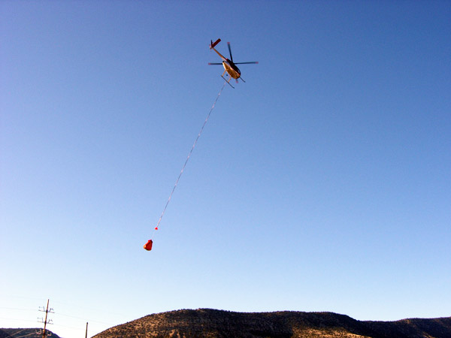
PRIVATE AIRCRAFT
Oil & Gas companies commonly use helicopters to support seismic operations and/or conduct routine pipeline inspections.
Contact your local Dispatch Center if you see a helicopter working in the area.
PROVIDE THE FOLLOWING INFORMATION
Where you see the helicopter working
Tail number (if possible)
Make and Model of the helicopter
(if possible)

Slide 13
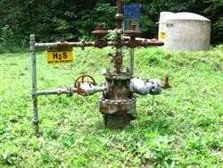
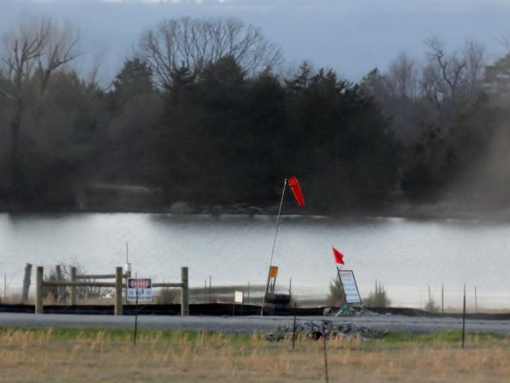
H₂S
REMEMBER YOUR GAS BADGE
Operations involving H2S
• Well Servicing
• Drilling
• Water Hauling
• Well Stimulation
• Production Operations
Plant Operations
LOCAL AREAS WITH H2S
3 mile radius of Rangely
Wilson Creek – NW of Meeker
Sources of H2S
• Confined spaces
• Tank Batteries
• Mud pits
• Circulating tanks
Wellheads
Produced water
Visual Indicators
Signs
Wind Socks

Slide 14
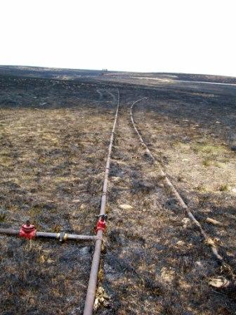
EXPOSED SURFACE PIPELINES
Flexible & Steel pipe are used as temporary distribution lines for gas and/or produced water.
Adjust tactics to avoid exposing personnel to potential rupture. Flexible pipe will not withstand the temperatures produced by a wildfire.
Report location to all assigned resources & Dispatch.
Contact operator to see if it can be shut off.
Industry informs us that “shut-off” is in fact more hazardous, the flow of gas inside the pipe acts as a cooling agent & shut off creates the effect of “shaking up a pop can”
CAUTION!!!!
Like an electrical line, it would still be charged with residual gas until purged.
Do not drive over exposed pipelines.

Slide 15
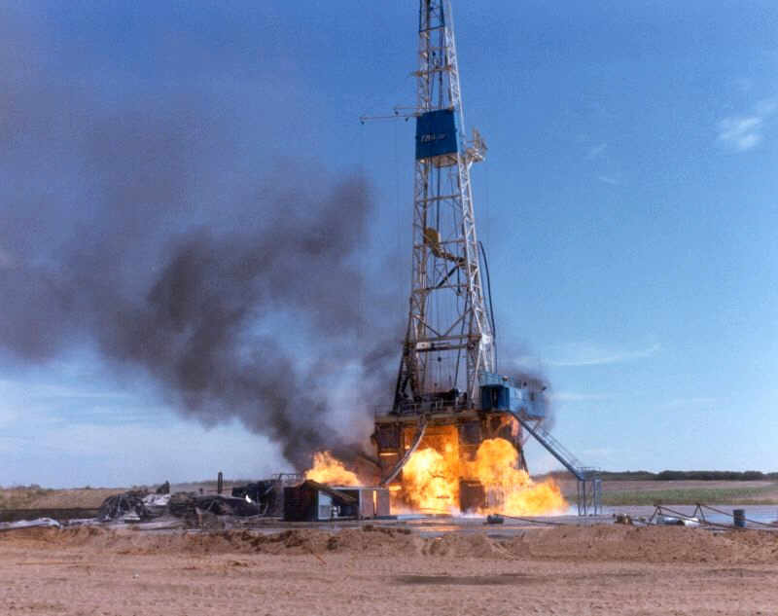
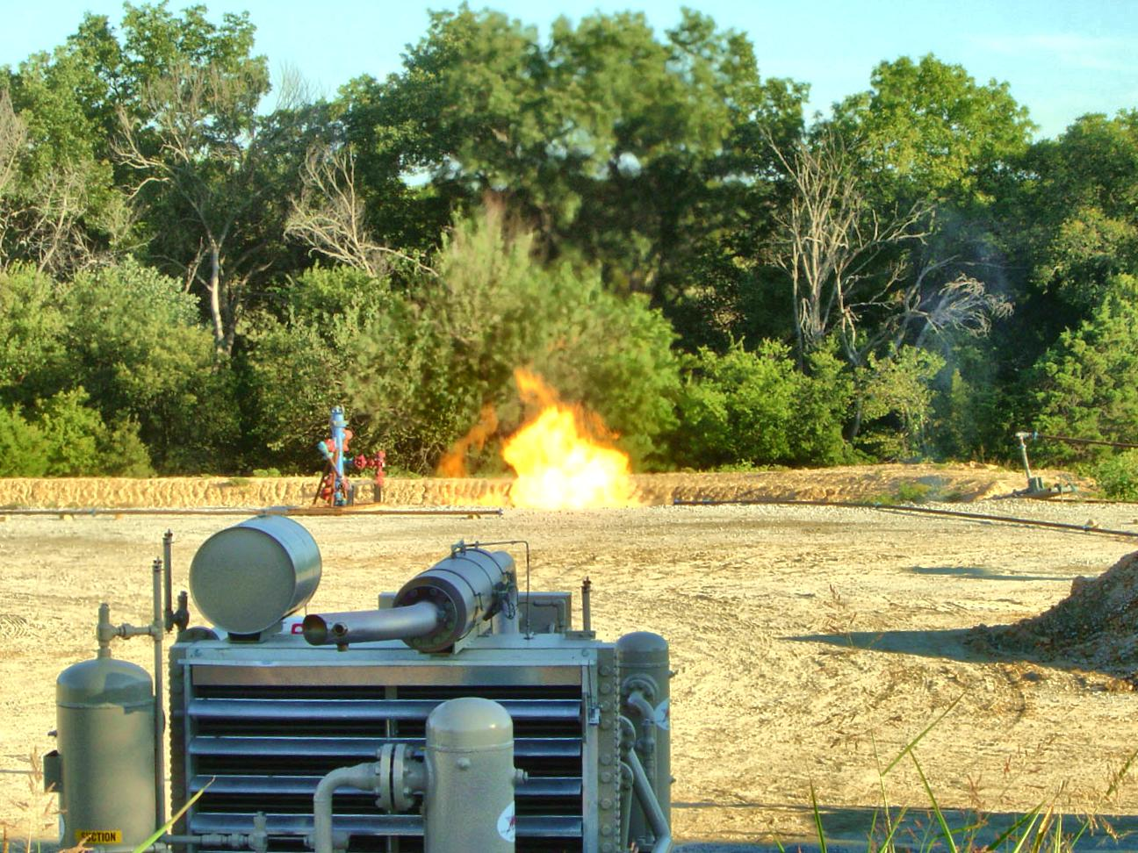
INDUSTRY RELATED FIRES
RIG & PIT FIRES
Avoid Smoke (Health Hazards)
Can Ignite Adjacent Fuels
Do not attempt to extinguish a rig fire or an involved pit
Concentrate your suppression efforts on the wildland fuels !!
Coordinate with industry and/or responding fire departments
High Intensity
Catchment pits do not contain just water… DO NOT use as a dip site

Slide 16
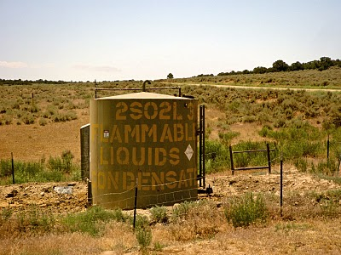
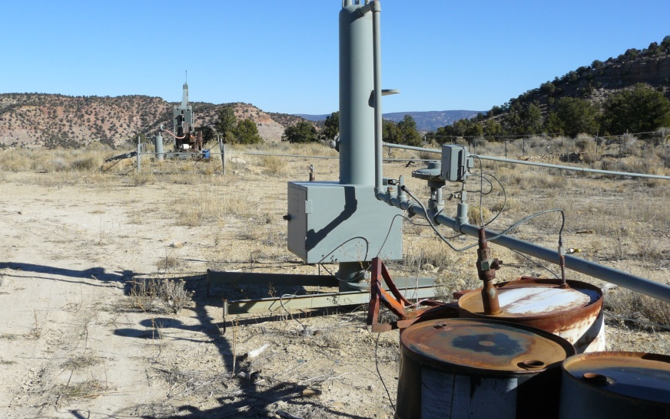
COMMON OIL & GAS FACILITIES
OLD WELL PADS
Driving obstructions
High pressure – Natural gas
Possible leaks
CONDENSATE TANKS
Contents are flammable
Do not use to fill engines

Slide 17
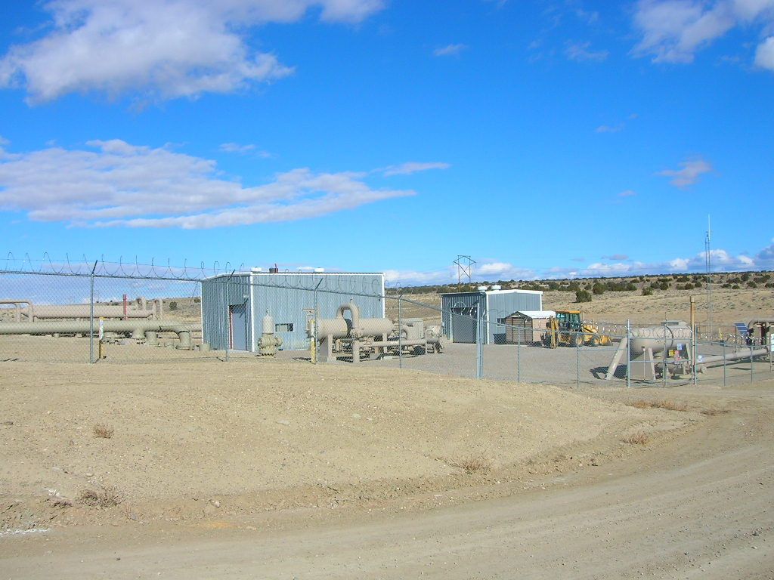
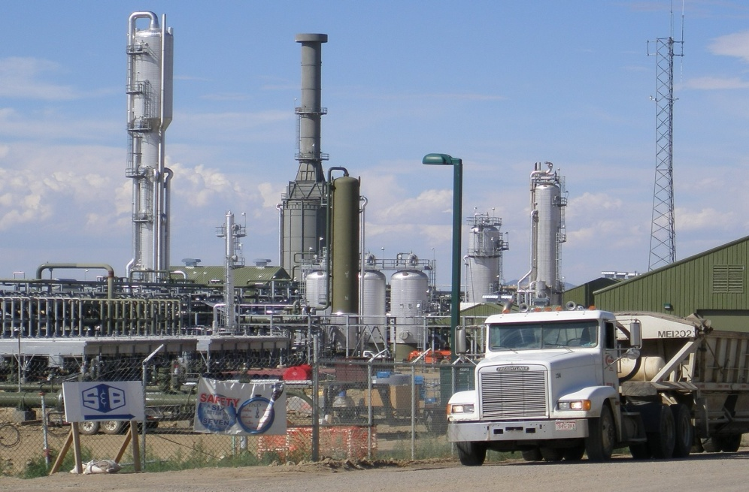
LARGE INDUSTRY FACILITIES
GAS PLANTS
1- 2 people – 24 hours a day
Pressurized natural gas
Pressurized vessels
Natural gas liquids & vapors
Buried installations
Amine (skin irritant)
COMPRESSOR STATIONS
Normally unoccupied
High pressure lines
Natural gas

Slide 18
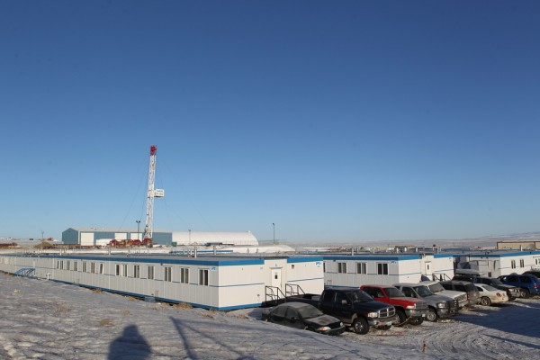
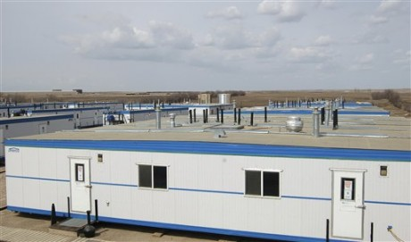
MAN CAMPS
Can be the size of a small town
with the potential for a large
number of evacuees
Some house as many as
400 workers
Possible structure protection
Is there a Safety Zone large enough for residents & suppression resources

Slide 19
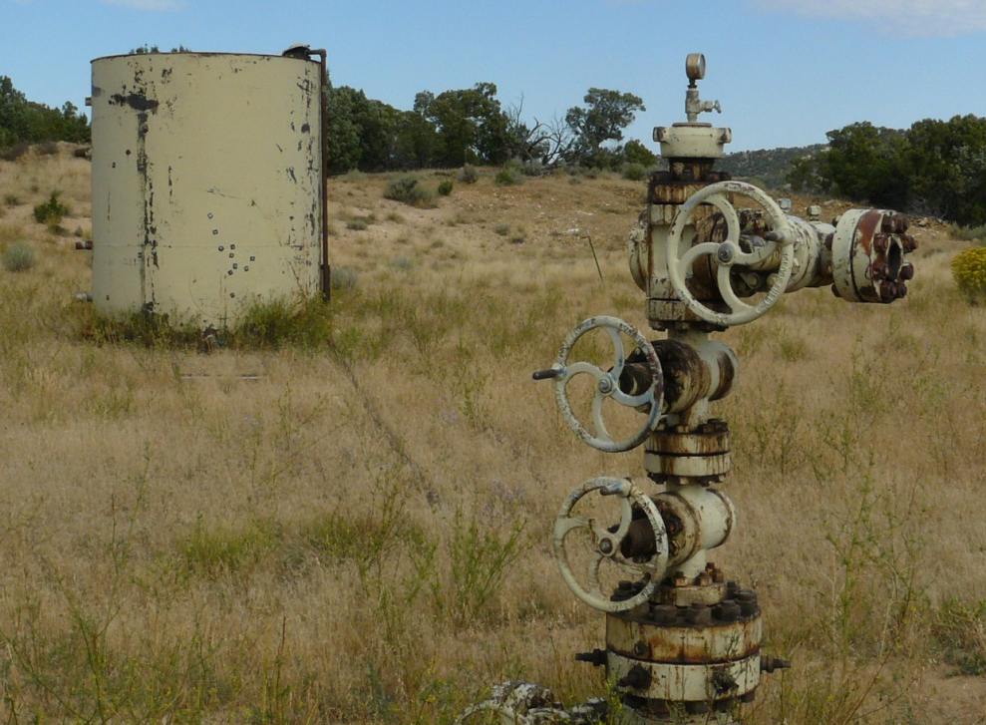
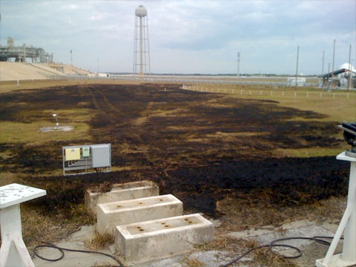
RISK vs.
GAIN
STAY
or
GO?

